Slide 1
STACK

Slide 2

What is a stack
The Stack in C# is a Non-Generic collection class that works in the LIFO (Last in First out) principle. So, we need to use the Stack Collection Class in C#, when we want Last-In-First-Out access to the items of a collection. That means the item which is added last to the collection will be the first item to be removed from the collection.
In order to understand stack collection, first, we need to understand the LIFO Principle as Stack works on the LIFO Principle. Let us try to understand the LIFO principle with an example. Imagine we have a stack of books where each book is added on top of the other. The last book which is added to the stack will be the first one to be removed from the stack. It is not possible to remove a book from the middle of the stack. For a better understanding, please have a look at the following image.
Stack is Defined as both generic and non-generic types
of collection. The Generic Stack is defined in
System.Collections.Generic namespace whereas
Non-Generic Stack is defined under
System.Collections namespace.

Slide 3
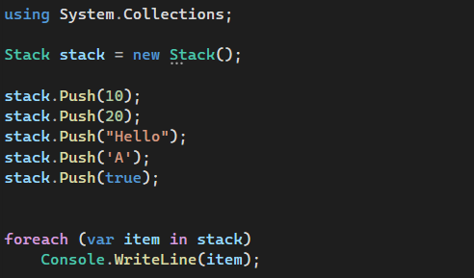
How to create a Stack.
Stack(): It is used to initialize a new instance of the Stack class that is empty and has the default initial capacity.

Slide 4

How to Add Elements into a Stack Collection
If you want to add elements to a stack, then you need to use the Push() method of the Stack class.Push(object obj): The push() method is used to insert an object on top of the Stack. Here, the parameter obj specifies the Object to push onto the Stack. The value can be null.

Slide 5
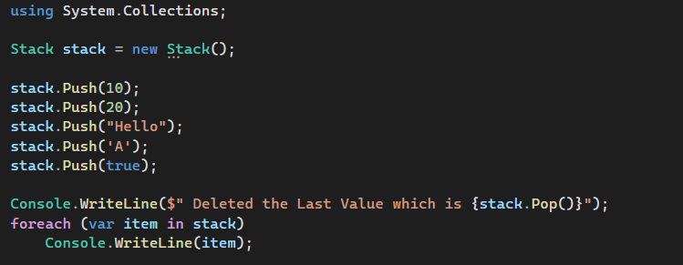
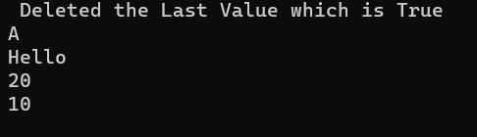
How to Remove Elements from a Non-Generic Stack Collection
In Stack, you are allowed to remove elements from the top of the stack. The Stack class in C# provides two different methods to remove elements. They are as follows:
Pop(): This method is used to remove and return the object at the top of the Stack. It returns the Object (element) removed from the top of the Stack.
Clear(): This method is used to remove all objects from the Stack.

Slide 6
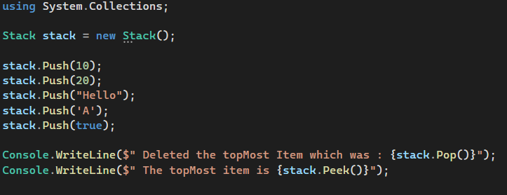

How to get the topmost Element of a Stack
Pop(): This method is used to remove and return the object at the top of the Stack. It returns the Object (element) removed from the top of the Stack. If there is no object (or element) present in the stack and if you are trying to remove an item or object from the stack using the pop() method then it will throw an exception i.e. System.InvalidOperationException
Peek(): The peek() method is used to return the object from the top of the Stack without removing it. If there is no object (or element) present in the stack and if you are trying to return an item (object) from the stack using the peek() method then it will throw an exception i.e. System.InvalidOperationException

Slide 7
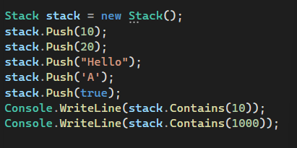

Check if an Element Exist
Contains(object obj): This method is used to determine whether an element is in the Stack. Here, the parameter obj specifies the object or element to locate in the Stack. The value can be null. It returns true if obj is found in the Stack; otherwise, false.

Slide 8
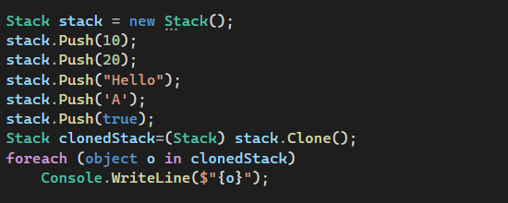

Clone
Clone(): This method is used to create and return a shallow copy of a stack object.

Slide 9
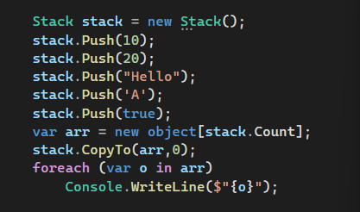
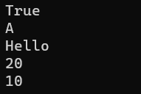
CopyTo
CopyTo(Array array, int index): This method is used to copy the Stack elements to an existing one-dimensional Array, starting at the specified array index. Here, the parameter array specifies the one-dimensional array that is the destination of the elements copied from the stack. The Array must have zero-based indexing. The index parameter specifies the zero-based index in the array at which copying begins. If the parameter array is null, then it will throw ArgumentNullException. If the parameter index is less than zero, then it will throw ArgumentOutOfRangeException

Slide 10
Properties of Non-Generic Stack Collection Class in C#
Count: It returns the number of elements contained in the Stack.
IsSynchronized: Gets a value indicating whether access to the Stack is synchronized (thread-safe). It returns true if access to the Stack is synchronized (thread-safe); otherwise, false. The default is false.
SyncRoot: Gets an object that can be used to synchronize access to the Stack. It returns an object that can be used to synchronize access to the Stack.

Slide 11
Summary
The following are important points that you need to remember while working with Stack in C#.
In C#, stacks are used to store a collection of objects in a LIFO (Last in, First out) style, i.e., the element which added last will come out first.
By using the Push() method, we can add elements to a stack.
The Pop() method will remove and return the topmost element from the stack.
The Peek() method will return the last (top-most) inserted element of the stack, and it won’t delete the element from the stack.

